Slide 1

Task #09 - Stakeholder Mapping
Stakeholder Mapping for Smartphone Product
T.BHAVANI-23781 A05F0
U.G.WAJIHA-23781A05F1
V.LAHARI-23781A05F5
V.YESHWITHA-23781 A05F6
V.P.LALITHA-23781A05F7
V.SIREESHA-23781A05F8
V.SUPRAJA-23781A05F9

Slide 2

Internal Stakeholders
- Product Manager: Oversees product development, launch, and maintenance
- Design Team: Responsible for designing the phone's user interface and user experience
- Engineering Team: Develops and tests the phone's hardware and software
- Marketing Team: Promotes the phone to target audiences
- Customer Support Team: Provides assistance to customers with phone-related issues

Slide 3

External Stakeholders
Customers:
Individuals who purchase and use the smartphone
Suppliers:
Companies that provide components, such as processors, memory, and displays
Partners:
Companies that collaborate with our company to offer exclusive services or promotions
Regulatory Bodies:
Government agencies that oversee the telecommunications industry
Competitors:
Other companies that manufacture and market smartphones

Slide 4
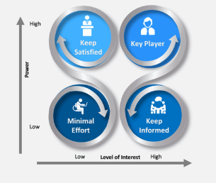

Power/Interest Matrix
- High Power, High Interest: Product Manager, Customers
- High Power, Low Interest: Regulatory Bodies
- Low Power, High Interest: Design Team, Engineering Team
- Low Power, Low Interest: Suppliers
STAKEHOLDER ANALYSIS
Identify key stakeholders and their interests
Analyze the level of influence and power each stakeholder has
Determine the potential impact of each stakeholder on the product

Slide 5

Stakeholder Engagement Strategy
- Develop a plan to engage with each stakeholder group
- Identify the communication channels and tactics to use
- Determine the frequency and timing of stakeholder engagement

Slide 6
Conclusion
Understanding the interests, influence, and power of each
Effective stakeholder engagement is key to ensuring the product meets the needs of all stakeholders
Thank you

